Slide 1
Welcome to…..
An Online Shopping App

Slide 2
Presented By-
Md Ikbal Hosen
Id: 17182103317
Md Sahrial Alam
Id: 17182103334
Md Sayedur Rahman
Id: 17182103297
Khairul Anam Mubin
Id: 17182103286
Supervised By-
Mamunur Rashid
Lecturer
Department of Computer Science and Engineering (CSE)
Bangladesh University of Business and Technology (BUBT)
Mirpur, Dhaka.

Slide 3
Contents
Introduction
Motivation
Objectives
Features
ER Diagram
Data Flow Diagram

Slide 4
Introduction
This project is an android based shopping system for an existing shopping mall. The project objective is to deliver the online shopping application into android platform. Online shopping is the process whereby consumers directly buy goods or services from a seller in real-time, without an intermediary service, over the Internet. It is a form of electronic commerce. This project is an attempt to provide the advantages of online shopping to customers of a real shop. It helps buying the products in the shop anywhere through internet by using an android device. Thus, the customer will get the service of online shopping and home delivery from his/her favorite shop.

Slide 5
Motivations
Online shopping application has transformed into one of the most popular app, both for consumers and owner. It provides a broad range of benefits such as 24/7 opportunity to purchase, online catalogues, comparative pricing, cost efficiency, less time consuming and a lot more. These are the reasons why we believe that this app is likely to grow in greater popularity in the future. In this aspect we focus on recognizing the motivational factors of online shopping. We believe that in the development of the future characteristics of e-commerce, future patterns of buying behavior would play a significant role.

Slide 6
Objectives
To provide an android application for online shopping of products in an existing shop.
To provide user friendly system
To provide error free system
To handle all the products as an admin/owner
Different interface for admin and consumers
Adding product or changing information facility about products for at any time for admin
Changing information process for consumers.

Slide 7
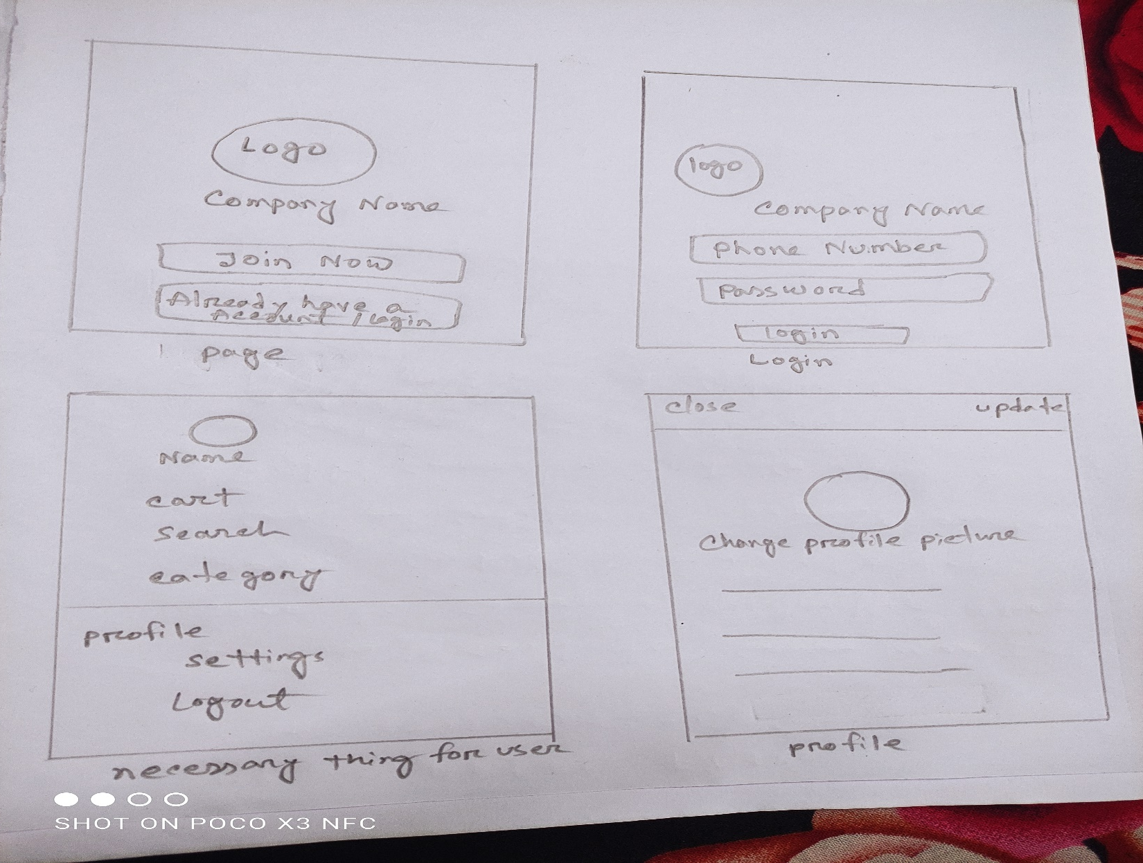
Features

Slide 8
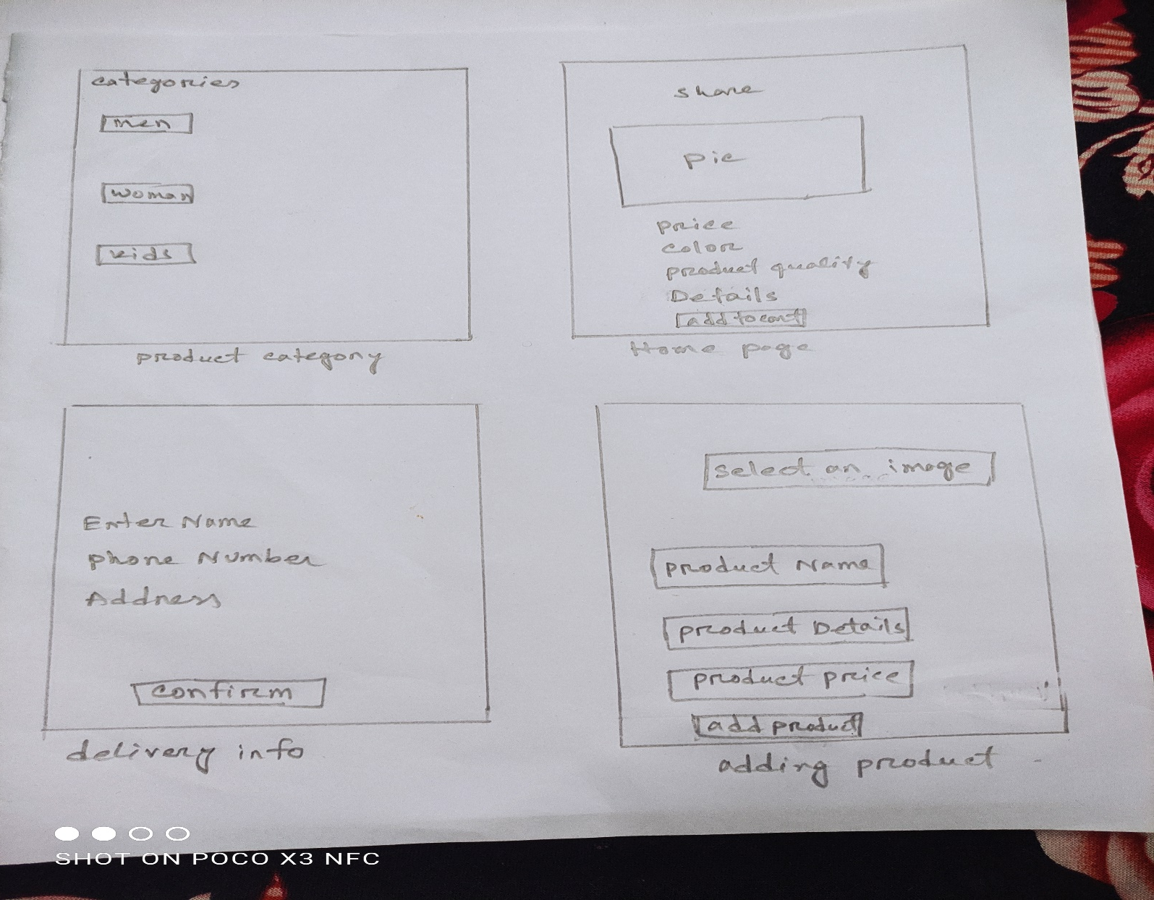
Continue

Slide 9
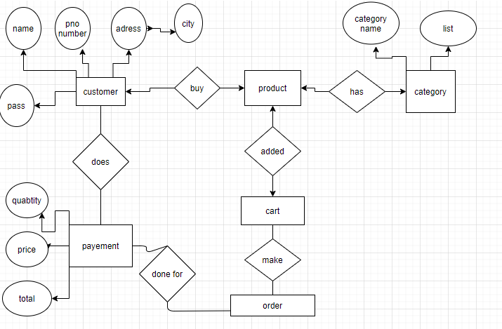
ER Diagram:

Slide 10
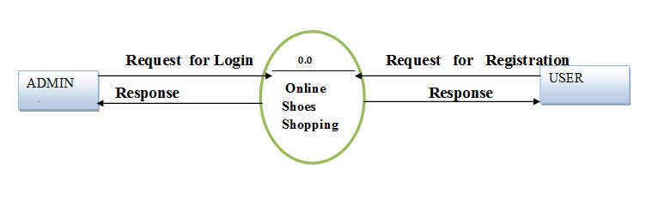
Data Flow Diagram
Add/delete/change Products View and Buy products

Slide 11

Thank You Everyone
Any Questions

